Slide 1




DECODE
ENCODE
Driving business growth through Clustering
and Linear Regression Modelling
ARDEN, AUSTINE, BEA, EVIAN, JAPHET
Notes:
Good Afternoon. We are DATASQU4D and this is our Project,
DECODE ENCODE
Driving business growth through Clustering and Linear Regression Modelling

Slide 2

ABOUT THE
CHALLENGE
Adobo Advantage Cards (AAC), a credit card company, collected comprehensive dataset of credit card transactions which includes:
DATASQU4D, one of the data science consultancy teams, was challenged to turn this data into actionable strategies that shall:
data
transaction details
Enhance customer satisfaction
customer demographics
Drive business growth
amount spent in various categories
Notes:
To derive insights and craft effective strategies as we decode AAC's dataset ...
next slide

Slide 3





METHODOLOGY
Data Preprocessing
Exploratory Data Analysis
RFM and
K-means Clustering
Cluster
Analysis
Linear Regression Modelling
DECODE ENCODE: Driving business growth through Clustering and Linear Regression Modelling
Notes:
... we utilized the following methodology.

Slide 4
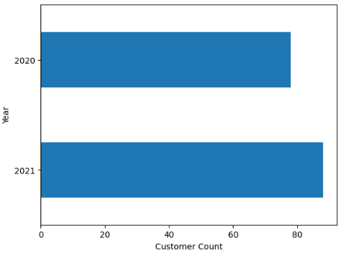
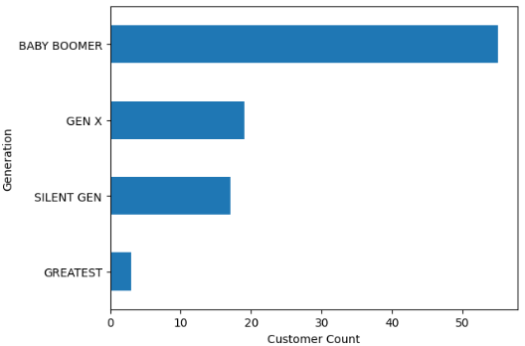
CUSTOMER
DEMOGRAPHICS
Based on AAC Credit Card Transactions as of December 7, 2021
94%
6%
51- 95
66
88 MALE
6 FEMALE
AGE RANGE
MEAN AGE
Active Customers per year
Generation Distribution
DECODE ENCODE: Driving business growth through Clustering and Linear Regression Modelling
Notes:
Using the data set, we found out that
AAC Credit Card Holders demographic shows a strong gender disparity,
with males comprising 94% and females just 6% of the cardholders.
Compared to 78 users in 2020, there was an increase in active customers in 2021, with 88 active users.
The age range of cardholders is between 51 and 90, with the mean age being 67.
The majority of these customers are from the Baby Boomer generation.

Slide 5
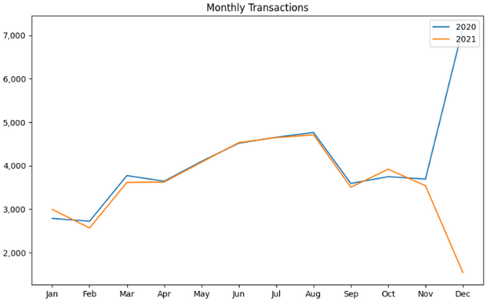
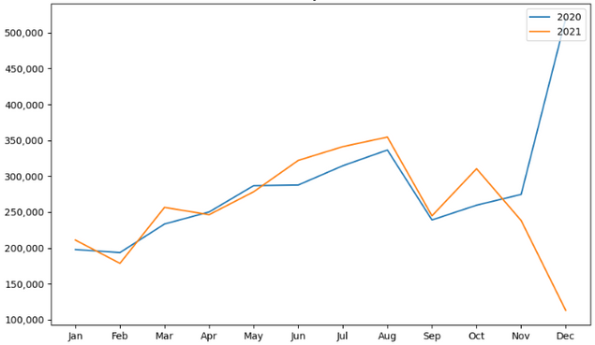
TRANSACTIONS
AND SPENDING
Based on AAC Credit Card Transactions as of December 7, 2021
YoY Monthly Transaction Counts
YoY Monthly Transaction Amount
DECODE ENCODE: Driving business growth through Clustering and Linear Regression Modelling
Notes:
Looking at these YoY Monthly Transaction counts and amounts, we can see that
Despite transaction counts remaining completely on trend, it's evident that certain months on monthly transaction amount struggle to be consistent with the overall trend.
Also, we can see that there was a significant dip in December 2021, primarily due to incomplete transaction records ending on December 7th.
(below not part of script)
^
It's highly likely that AAC prepared this dataset as a preparation for year-end promotions.
By analyzing transaction trends and identifying months where spending dips or struggles to keep up with the trend, AAC can effectively target its promotional efforts to boost spending. Understanding customer behavior and spending patterns allows AAC to tailor its promotions and incentives to encourage increased card usage and drive revenue growth, especially during key times like the year-end holiday season.

Slide 6
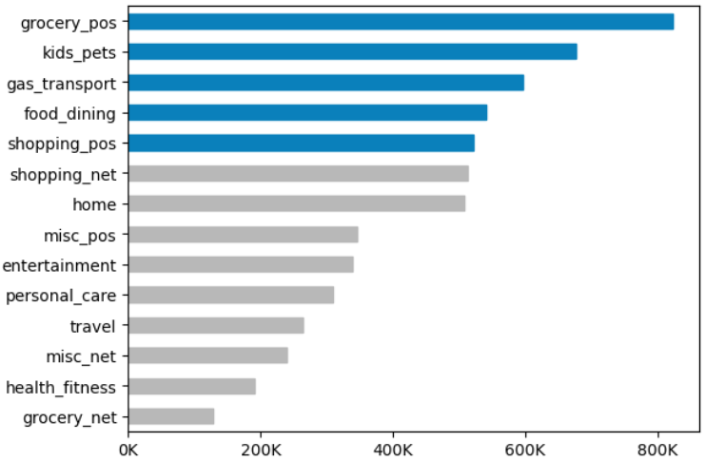
CATEGORY
SPENDING
Based on AAC Credit Card Transactions as of December 7, 2021
All Time Top 5 Categories by Total Amount
AAC Credit Card Holders are family-oriented, mobile, socially active, and financially confident . . .
DECODE ENCODE: Driving business growth through Clustering and Linear Regression Modelling
Notes:
In here, we can see the top categories that drive AAC customers' spending.
The high expenditure on groceries and kids and pets indicates that the cardholders prioritize essential and family-related expenses.
Significant spending on gas_transport, food_dining, and shopping points to a lifestyle that values mobility and social activities.
Overall, these insights suggest that AAC Credit Card Holders are family-oriented, mobile, socially active, and financially confident, providing a clear direction for targeted marketing and service offerings.
Now, let's head on to the next slides to know more about AAC's customers and their spending behavior.

Slide 7
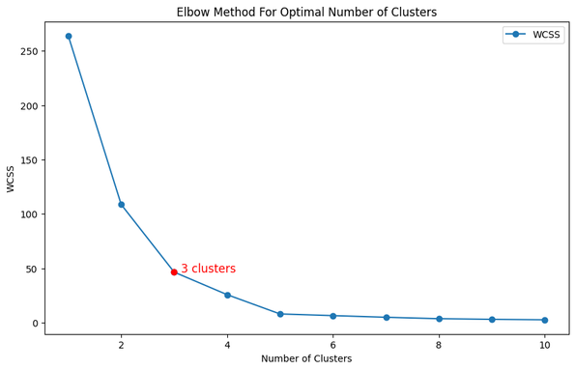
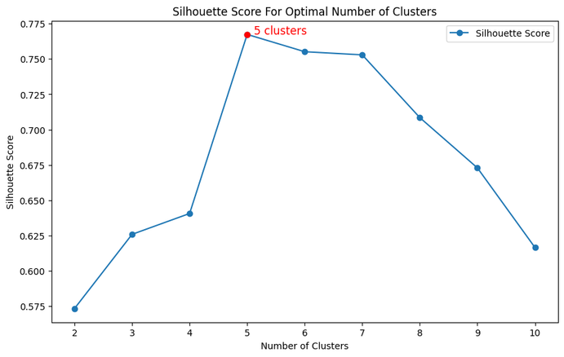
CUSTOMER
SEGMENTATION
Choosing Appropriate Number of Clusters for the Data Set
Elbow Method and Silhouette Score for Optimal Number of Cluster
The 3-cluster model offers a simpler segmentation of high, medium, and low-value customers. While the 5-cluster model provides more detailed insights, identifying 5 distinct subgroups
DECODE ENCODE: Driving business growth through Clustering and Linear Regression Modelling
Notes:
- Based on our clustering analysis , the elbow method suggests 3 optimal clusters while the silhouette score indicates 5.

Slide 8
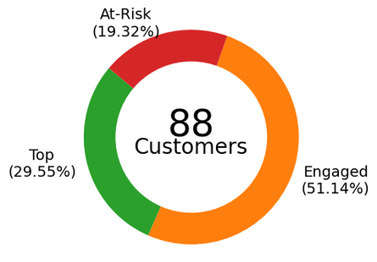
CUSTOMER
SEGMENTATION
Based on AAC Credit Card Transactions as of December 7, 2021
Customer Distribution
Across Clusters
K-Means Clustering Results
 | Mean Recency | Mean Frequency | Mean Monetary | Number of Customers
Top | 25 | 906 | $63,802 | 26
Engaged | 25 | 435 | $30,000 | 45
At - Risk | 192 | 8 | $5,130 | 17
DECODE ENCODE: Driving business growth through Clustering and Linear Regression Modelling
Notes:
Cluster 1:
Recency: High (mean ~191.76, median ~141) Frequency: Low (mean ~9, median ~9) Monetary: Low (mean ~5325.40, median ~5573.74) Count: 17 Interpretation: Customers in this cluster have not made a purchase in a long time, buy infrequently, and spend less. They might be at risk of churning.
Cluster 0:
Recency: Very low (mean ~24.48, median ~24) Frequency: Very high (mean ~1055.59, median ~990) Monetary: Very high (mean ~73569.62, median ~69221.70) Count: 27 Interpretation: These are highly active and valuable customers who purchase frequently and spend a lot. They are your top customers.
Cluster 2:
Recency: Low (mean ~24.77, median ~25) Frequency: High (mean ~467, median ~348) Monetary: Moderate (mean ~32482.28, median ~27812.70) Count: 39 Interpretation: Customers in this cluster are also active but with a moderate level of spending compared to Cluster 1.

Slide 9

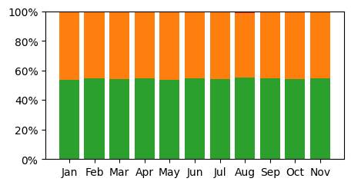
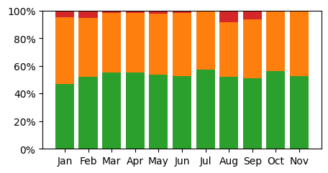
CUSTOMER
SEGMENTATION
Based on AAC Credit Card Transactions as of December 7, 2021
Transaction Distribution
Spending Distribution
Top Customers:
50-55% of transaction volume & expenditure
Engaged Customers:
Significant contribution to volume & expenditure
At-Risk Customers:
Minimal transaction activity. Only notable expenditure for 4 months
DECODE ENCODE: Driving business growth through Clustering and Linear Regression Modelling

Slide 10
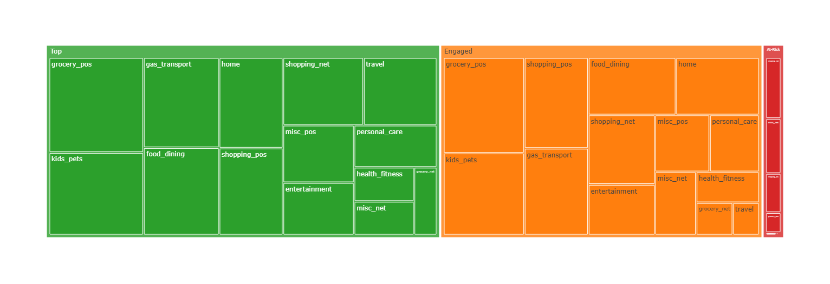
CUSTOMER
SEGMENTATION
Based on AAC Credit Card Transactions as of December 7, 2021
Customer Spending per Cluster and Category
Top and Engaged customers spend the most in physical grocery stores (grocery_pos).
At-Risk customers spend the most in online shopping (shopping_net)
DECODE ENCODE: Driving business growth through Clustering and Linear Regression Modelling

Slide 11
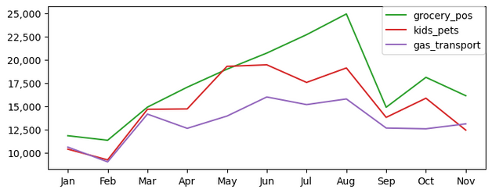
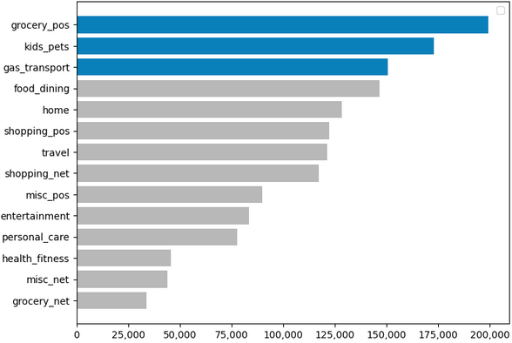
TOP
CUSTOMERS
Highly active and valuable customers who purchase frequently and spend a lot
Top Customers’ Top 3 Categories
Introduce special bonuses, such as extra cashback or double points on key months
Develop loyalty programs with exclusive offers and personalized rewards
Explore opportunities for cross-selling and upselling within the top categories
DECODE ENCODE: Driving business growth through Clustering and Linear Regression Modelling
Notes:
Segment: Top Customers
Top 3 categories
-grocery
-kids and pets
-gas and transport
Since these are highly active customers who purchase frequently, we can see relatively consistent spending patterns throughout the year.
From the pattern, we can observe that the first few months (Jan-Feb) of the year have the lowest amount spent
We can Introduce special bonuses, such as extra cashback or double points during these months for the top categories to incentivize continued spending during the holiday season
Since these are valuable customers we could also
develop loyalty programs and create a sense of exclusivity to make customers feel special and valued. Offer exclusive perks and benefits reserved for program members, such as VIP events or early access to sales.
To further improve the performance of the top categories, we could also explore opportunities for cross-selling and upselling. Encourage customers to explore related products or services that complement their purchases, thereby increasing transaction value.

Slide 12
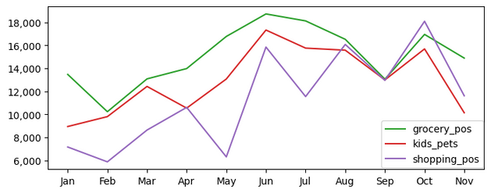
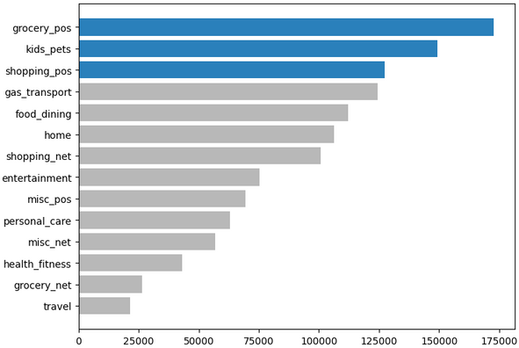
ENGAGED
CUSTOMERS
Active but with a moderate level of spending compared to top customers
Engaged Customers’ Top 3 Categories
Design targeted promotions that encourage higher spending, such as spend-and-get offers
Offer seasonal incentives during key months to boost spending.
DECODE ENCODE: Driving business growth through Clustering and Linear Regression Modelling
Notes:
Segment: Engaged Customers
Top 3 categories
-grocery
-kids and pets
-shopping
Compared to the top customers, the engaged customers have volatile spending patterns.
To boost some of the dips in some months for specific categories, design targeted promotions and offers that encourage higher spending, such as spend-and-get offers where customers receive a reward after spending a certain amount within a certain period
There are also some months where all categories need improvement we could offer seasonal incentives during key months, such as February and September to boost spending. These could include limited-time discounts or holiday-themed rewards.

Slide 13
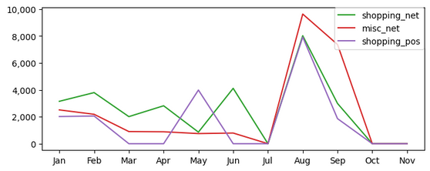
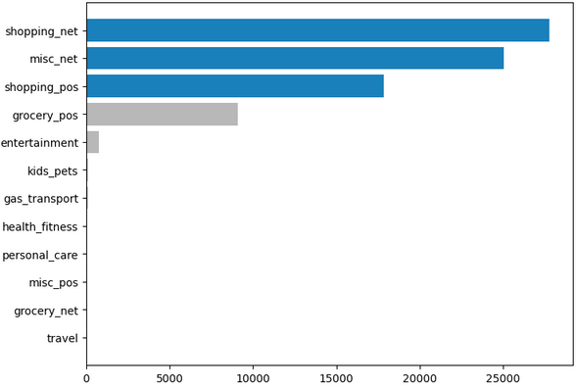
AT-RISK
CUSTOMER
No recent purchases, buy infrequently, and spend less. They might be at risk of churning
At-risk Customers’ Top 3 Categories
Develop targeted communication campaigns and strategies to keep members informed about program updates, rewards, and special promotions.
Create offers specifically designed to entice at-risk customers back into using their AAC credit cards. Offers include attractive discounts and waived fees.
DECODE ENCODE: Driving business growth through Clustering and Linear Regression Modelling
Notes:
Segment: At-risk Customers
Top 3 categories
-shopping_net
-misc_net
-shopping_pos
As observed in the trend, there are only spikes in certain months, since these customers spend infrequently and less, focusing on offers specifically designed to entice at-risk customers back into using their AAC credit cards. Offers include attractive discounts or waived fees.
For re-engagement, we could also develop targeted communication campaigns and strategies to keep members informed about program updates, rewards, and special promotions. Utilize email, SMS, push notifications, and social media to engage with members regularly.

Slide 14
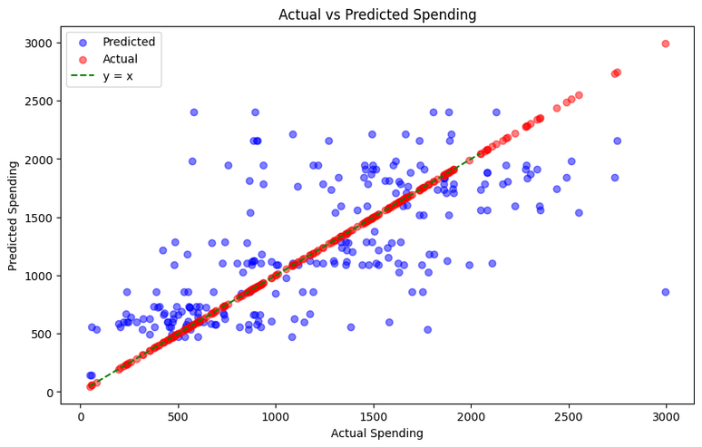
Supervised Learning:
Linear Regression
grocery_pos
kids_pets
gas_transport
Data date ranged: Jan 2020 to Nov 2021
Training Data: Jan 2020 to Dec 2020
Predicted Data: Jan 2021 to Nov 2021
Note: The limitation of this model is that it was trained using only one year of data.
Metrics to help evaluate the model's performance:
R-squared: 0.47
Root Mean Square Error: 513.82
Mean Absolute Error: 382.51
Mean Absolute Percentage Error: 41.57
Notes:
The purpose of creating this linear regression model was to determine the relationship between total customer spending and the top three spending categories: grocery_pos, kids_pets, and gas_transport.
To achieve this, we used transaction data from January 2020 to November 2021. We grouped the total spending and total transactions for these categories from January to December 2020 to train the model. The model then predicted the total amount spent from January to November 2021.
Note: The limitation of this model is that it was trained using only one year of data.
Our model achieved an R-squared of 0.47, indicating a moderate positive correlation. This means that fluctuations in customer spending within the top three categories (grocery_pos, kids_pets, gas_transport) are likely to affect the overall spending and, consequently, the company's revenue.
For instance, a decrease in customer spending or transaction volume in these categories suggests a potential drop in total revenue, and vice versa.
This insight can help us develop an alert system to monitor trends in these critical categories. If a decreasing trend is detected, prompt action can be taken to mitigate potential revenue losses.
Notes from Ian:
-Can be used to create an alert system
-Limitations: trained with 1 year data
-If this categories are increasing, then the amount of spent is increasing and vice versa
-Hinde temporal trend and features but categories

Slide 15

STREAMLIT
DEPLOYMENT

Slide 16
DATASQU4D
Arden Sarmiento
Austine Wong
Bea Reyes
Evian Aguilar
Japhet Pamonag
Thank you!

